Slide 1
Josiah Abigail Patterson Campbell
Legacy of Slavery
A 10 minute Coming to the Table presentation 02.20.2022
By Meredith Coleman McGee, a Black great great-granddaughter
Profession: Mississippi writer, author, poet, book collector, book publisher
Ethnicity: African, Aztec, Choctaw, Cherokee, English, Scottish Irish

Slide 2
FACTS:
Parents: Presbyterian Min. Robert Bond Campbell & Mary Ada Patterson
Graduate, Princeton Theological College, now Princeton University
Maternal Grandfather Josiah Patterson, Wealthy Planter
Abbeville, SC, 1790 2 slaves. 1820 Census 21 slaves.
1830
Josiah Abigail Patterson (JAP) Campbell
Born, Camden, Abbeville District, SC
1850 marries
1851 MS Law maker
Marries Eugenia Elizabeth Nash in 1850
Daughter of William Whitfield Nash 1802-1871, Founder, 1st Baptist Church of Kosciusko
State Legislature at age 21
Family moves to MS
becomes lawyer - age 17 Kosciusko, Attala County, Mississippi
1860 Speaker of the House
Owned
9-11 slaves
1845
graduates - age 15
Davidson College
School est. 1837
Mississippi Legislature

Slide 3
Milestones
New Codes:
emancipated women from disability of coverture
Abolished Dower and Curtesy – gave surviving spouse liberal share of estate.
Tenants in common land titles
1888-1894
1887
JAP, Chief Justice, MS Supreme Court
Mississippi legislature invited JAP Campbell to draft Mississippi codes
Paid $3.500 for services 11.01.1880
MS Supreme Associate Justice, 1876
appointment by Gov. John H. Stone
Legacy is an amount of money or property left to someone in a will.
Slavery is a civil relationship whereby one person has absolute power over another and controls his/her life, liberty, and fortune.

Slide 4
Legacy of Slavery – Land Grants = Welfare
Province of SC granted land under the Crown: Single man or woman 16 years + 100 acres. Married man or widow 100 acres + 50 acres for each child.
JAP’s Maternal Great Grandfather - Samuel Patterson, 1725, Dysart, Newry, County Down, Ireland. Died, age 66, Abbeville, SC 1791 – 350 acres - 02.12.1773 Hillsborough, Township. Samuel had 6 slaves. Wife – Mary Margaret Carson, 1730 Newry, County Down, Ireland. Died, age 90, Abbeville Dist, SC.
Ship: FreeMason … Church: Hopewell Church

Slide 5
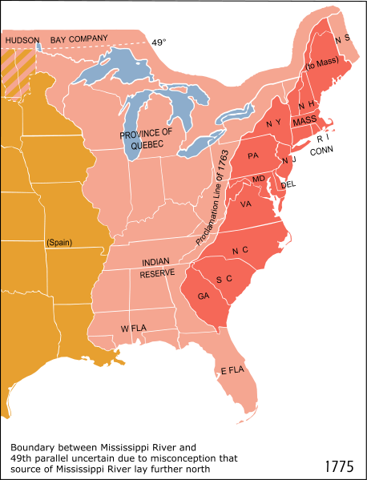
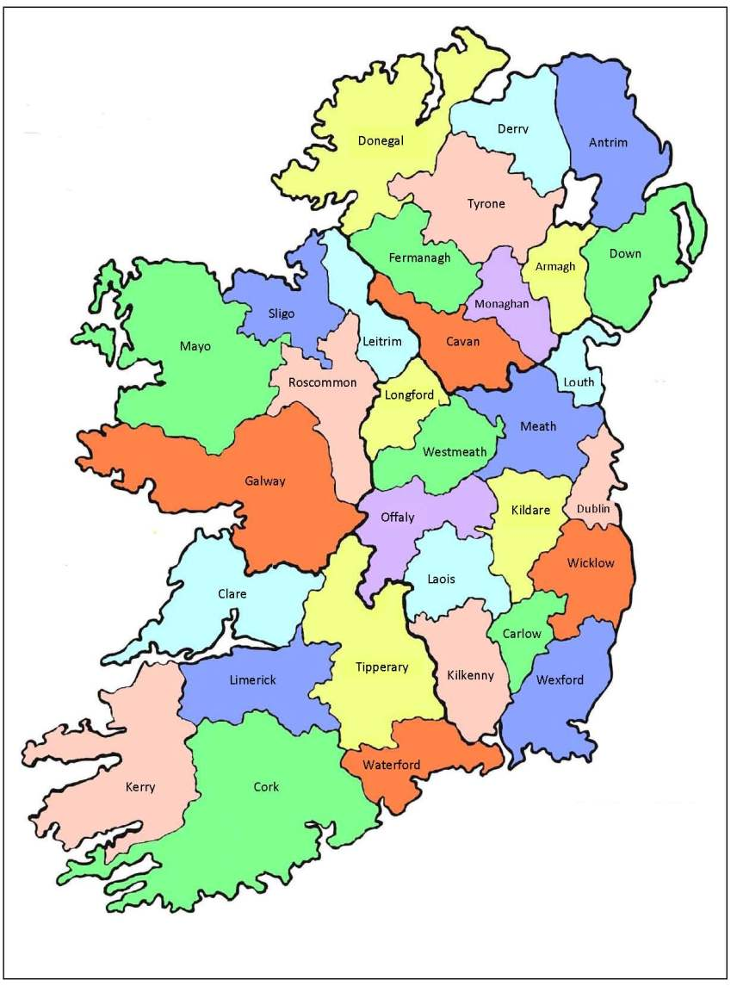
Present day UK
3rd wave of
immigrants
IRELAND

Slide 6
The mass immigration of the Scot-Irish took place over a 58-year span between 1717 and 1775. “Great Migration” occurred in five “waves”. The first three waves established major settlements in the colonies. The first and second waves landed in Philadelphia and the Delaware River in Pennsylvania. The third wave of immigrants moved into Virginia and beyond.

Slide 7
Irish immigrants arrived in America in droves 100,000s in 1718. mostly Scottish origin – promised cheap land & a fresh start.
The American Dream

Slide 8
Ireland Catholics were socially marginalized by penal laws introduced in 1600s … strengthened Protestant grip on Ireland's economy. Penal laws - Catholics could not vote, hold office or send their children abroad to be educated in Catholicism.
Catholics were prohibited from willing their land to the eldest son, as Protestants did. Land was divided among all male heirs which reduced each heir's individual land ownership.

Slide 9
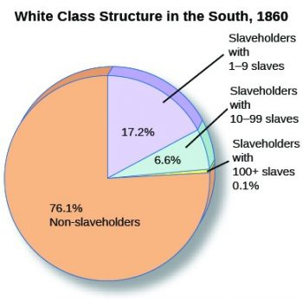

Slide 10
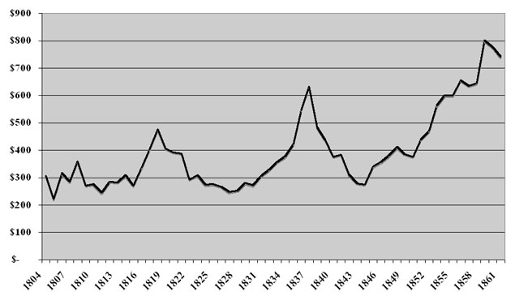
1860 – U.S.A.
4 million slaves market value $3.6 billion

Slide 11
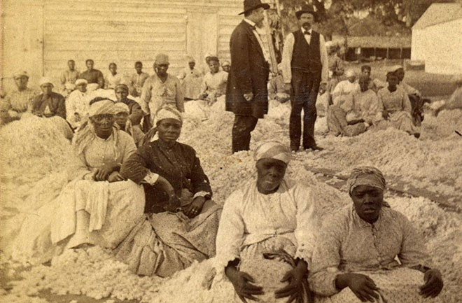

Slide 12

The Pen is mightier than the sword
DEFINITION proverb writing is more effective than military power or violence.

Slide 13
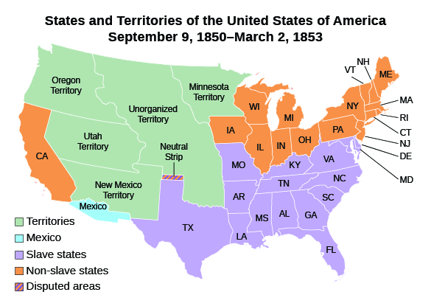

Slide 14
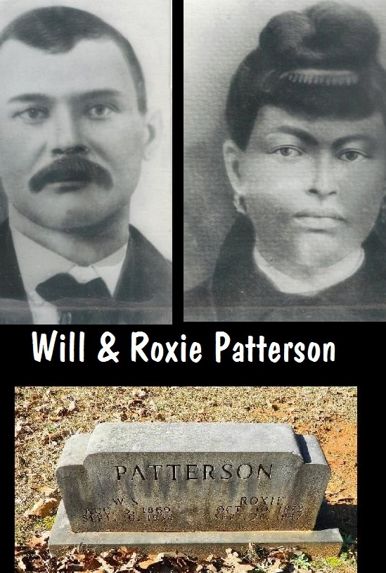
William and Roxie Hickman Patterson
William, 1870 – 1934, Center, MS
Son of Columbus Patterson, 1842, SC
Roxie, 1874-1947, daughter of
Attala County Judge Harvey Davis
Columbus, son of William Patterson
Caroline Patterson, slave, 1819, SC
Center, Attala County, MS died

Slide 15
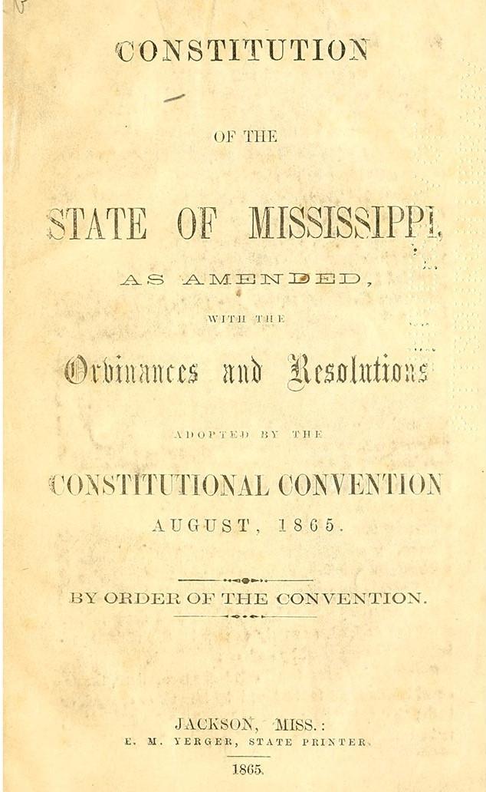
May 9, 1865 – President Andrew Johnson declares that armed resistance and insurrection against the United States is “virtually at an end.”
May 10, 1865 – Jefferson Davis is captured.
1865 – Mississippi becomes the first state to enact Black Codes that restrict the rights and status of African Americans after the Civil War. Other former Confederate states soon follow.
Yergers
State
Printers
1865

Slide 16
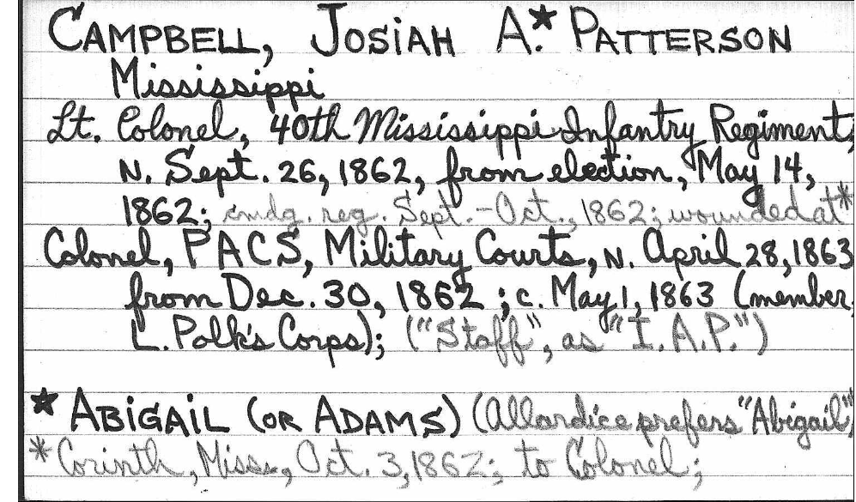
Colonel, PACS, Military Courts 04.28.1863

Slide 17
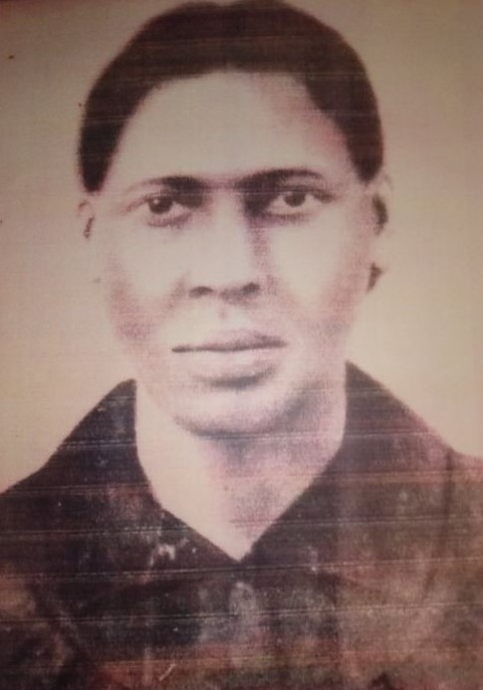
Francis Brown
1865 – 1905 daughter of
JAP Campbell
1830-1917
Millie Brown, slave

Slide 18
Francis Brown marries Ned Meredith, in Attala County, Kosciusko, MS in 1888.
Oral history - Francis was a schoolteacher when they married and was fired after marriage.
Ned Meredith was illiterate. Occupation Sharecropper
Nov. 1, 1890 – Mississippi adopts new constitution that greatly diminishes the political power of African Americans by restricting their voting rights. It also creates racially segregated schools and a new school funding mechanism that allows wealthy, white school districts to levy taxes for education revenue far in excess of the taxes generated in poor, largely African-American districts.
2022 – 1865 = 157 years

Slide 19
Nannie Campbell Yerger, $$ social capital
Edward Yerger, 1862-1943, son of Capt. William Swan Yerger, 1831-1868, Yazoo City Plantation, Civil War hero, MS Senator, (1860 owned 120 slaves), Smithsonian
Nannie’s grandson, Hinds County Circuit Judge
Judge Swan Yerger, retired 2006, age 89 now

Slide 20
JAP Campbell & Eugenia Nash Campbell
Children - Occupations:
Josiah Abigail Patterson Campbell Jr., 1858-1905, Businesses
Harmon Publishing Company, printing business
Large Plantation interest, Mississippi Delta, sharecroppers
Minnie Campbell Dameron, Leadership,
Daughters of the Confederacy
Nannie Campbell Yerger, Leadership, wife of Edward Yerger
Daughters of the Confederacy

Slide 21
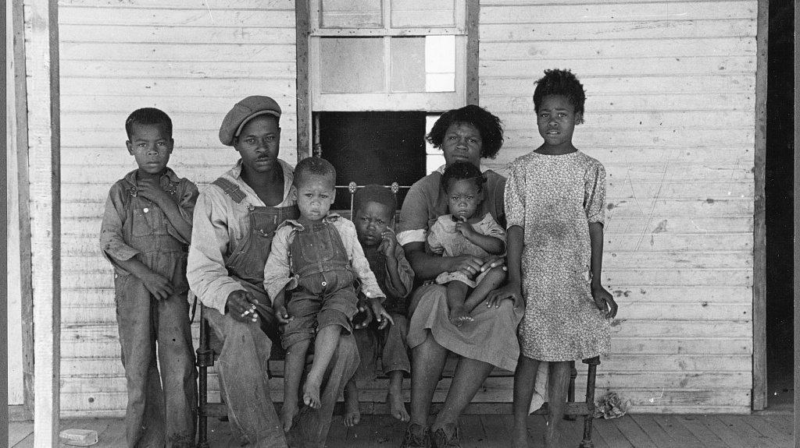
Sharecropping Family

Slide 22
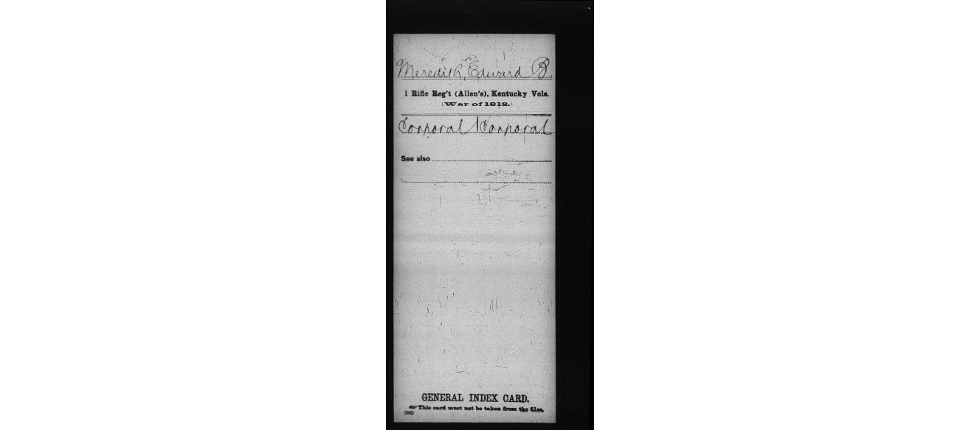
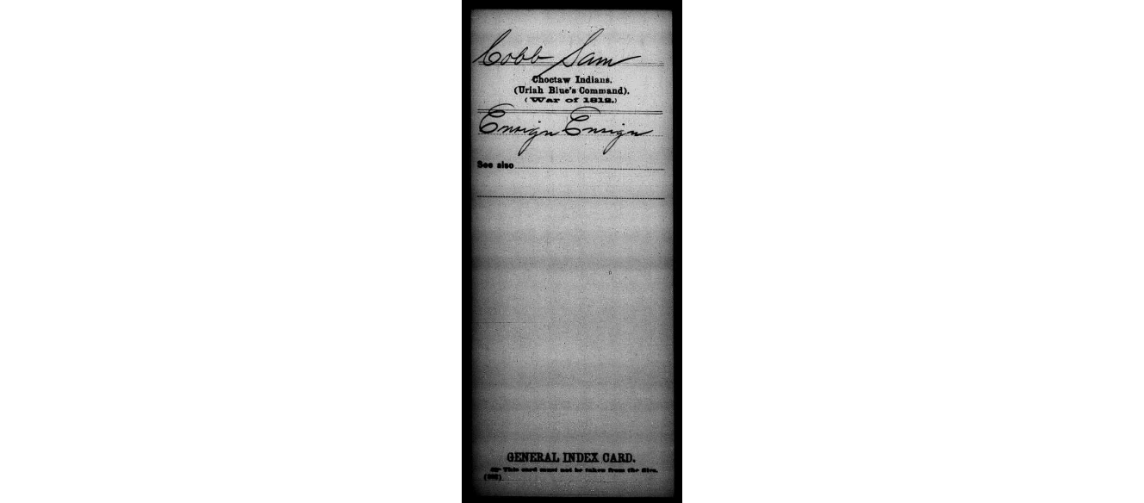
Edward Meredith
obtained a land grant 698 acres from 1841-1846 of former Choctaw land in Attala County
Sam Cobb was forced to flee his log cabin on the Natchez Trace Rd. after 1830. promises null & void.. WAR 1812

Slide 23
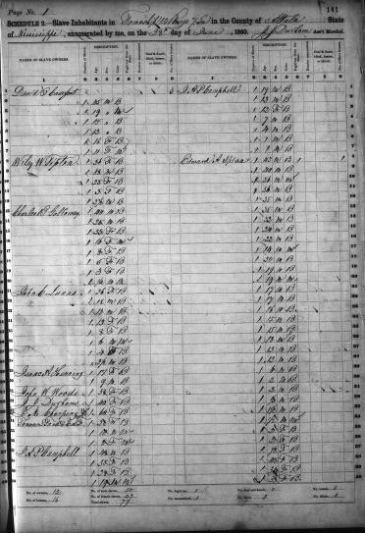
JAP Campbell
1860 Slave Schedule
Kosciusko, Attala Co, MS
7 slaves
Another schedule
11 slaves

Slide 24
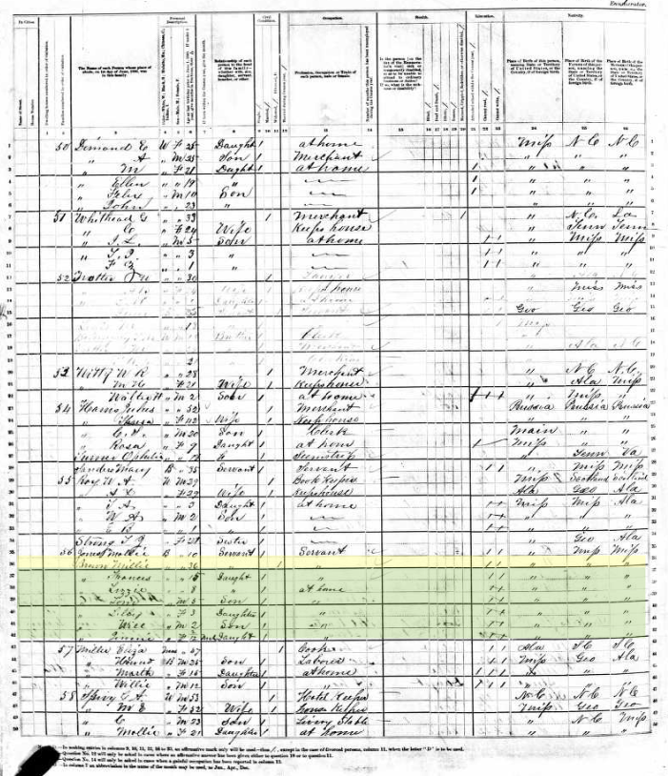
Millie Brown, 1844
Age 21 when Francis was born in 1865

Slide 25
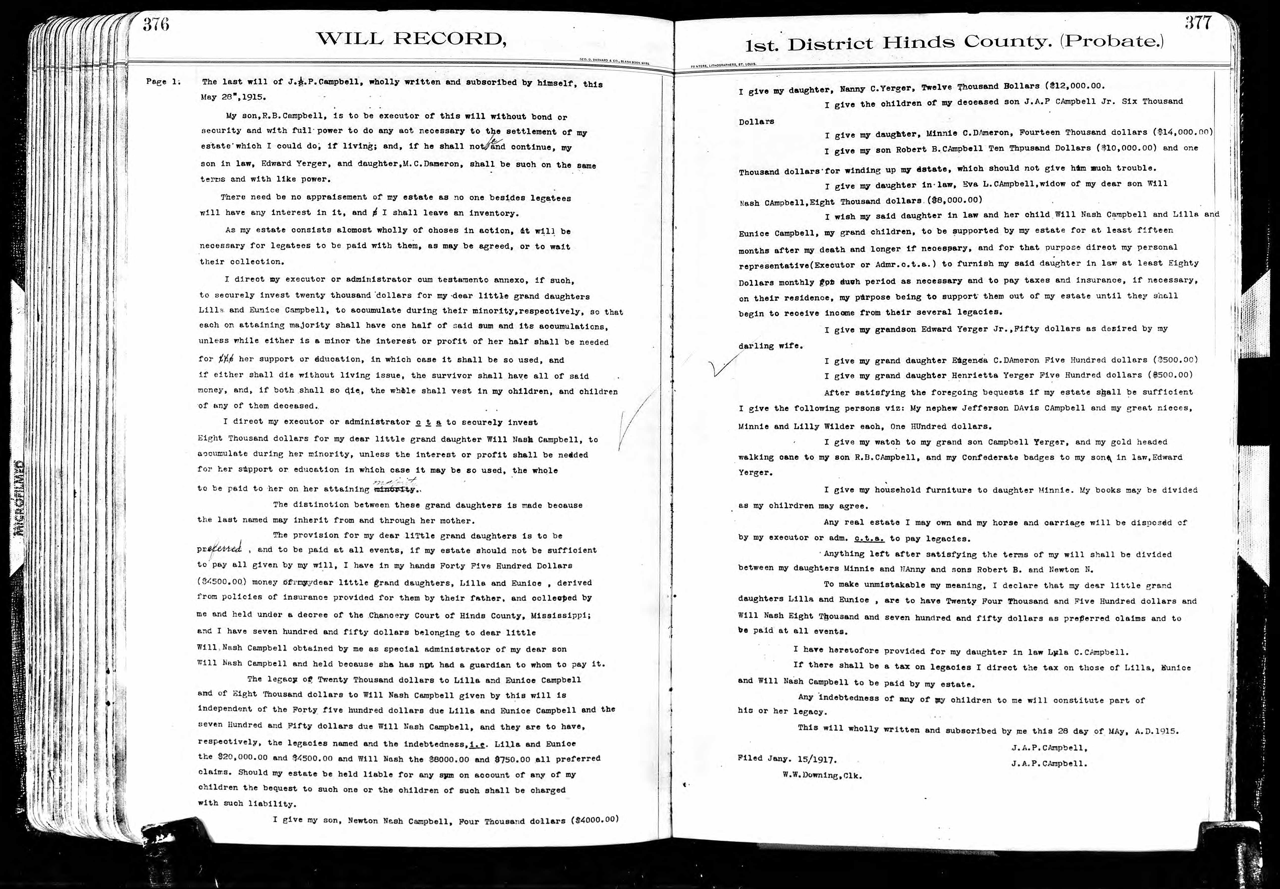
Nanny C. Yerger, bequest $12K
Minnie Dameron, $14K
Divided books among children
Walking cane to Jr.

Slide 26
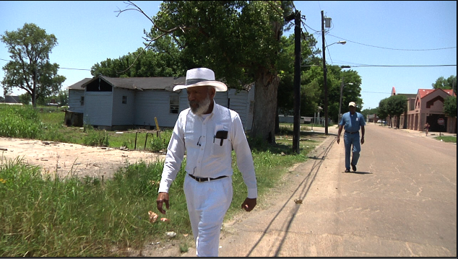
James & Arthur Meredith, 2009, Walk for the poor – Tutwiler, MS

Slide 27
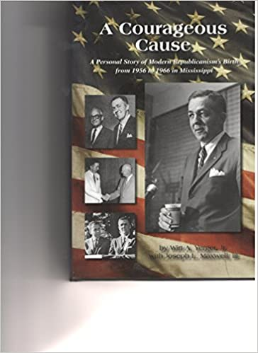
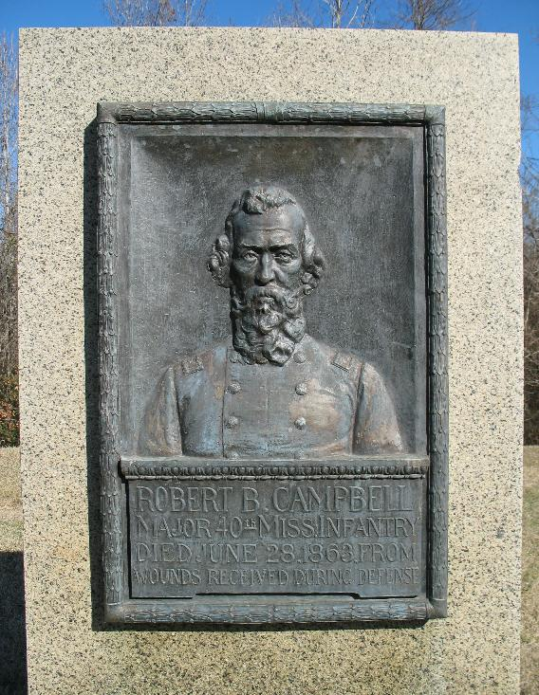
Wirt Adams Yerger, 1930, Chairman, MS Republican Party, Ross & Yerger Insurance, Memoir, A Courageous Cause: A Personal Story of Modern Republicanism's Birth from 1956 to 1966 in Mississippi.
Hinds County Circuit Judge
Swan Yerger, 1932-
Maj. Robert B. Campbell, right
1832 -1863, age 31
Killed July 1, 1863
Siege of Vicksburg, MS
Memorized at the Smithsonian

Slide 28
Children of Ned and Francis
Alberta Meredith Estes, 1887, 40 acres
Lee Roy Meredith, 1886, land, Attala Co.
Moses Arthur (Cap) Meredith, 1891, 84 acres
Eddie Meredith, 1893
Jessie Meredith, 1895, home, Kosciusko, MS
Willie Lou Meredith,
Eugene (Plunder) Meredith
Elyses (Plain) Meredith
Clifton (Cliff) Meredith, 1902, St. Petersburg, FL

Slide 29
Cap’s children: land/occupations
Emmitt Meredith, 1916, home, Detroit, Street Car operator
Lee Roy Meredith, 1917, home, Kansas, Army Corp, 1940
Delma Meredith Leake, 1920, home, Detroit
Thelma Meredith Franklin, 1922, home, Detroit
Miriam Meredith Griffin, 1926, home, St. Petersburg, Teacher, MA
J.H. James Howard Meredith, 1933, purchased, 84 + 40 + 3 = 127 father and Aunt Alberta’s land, Airforce, Taxi Co. Tree farmer
Everett Meredith 1936, land, Attala Co., home, FL & GA, Airforce
Hazel Janell Meredith (Coleman Hall), 1939, 40 acres, home, MS
Claudell Arthur Meredith, 1942, Airforce, home, MS
Willie Lou, 1945-1968, died age 23

Slide 30
Black millennials (ages 21-36) homeownership rates are trending downward @ just 16% in 2017.
The Black-White homeownership gap exceeds that of every previous generation of Americans since WWII.
Land and or home ownership are usually a family’s greatest asset and the beginning of wealth creation.

Slide 31
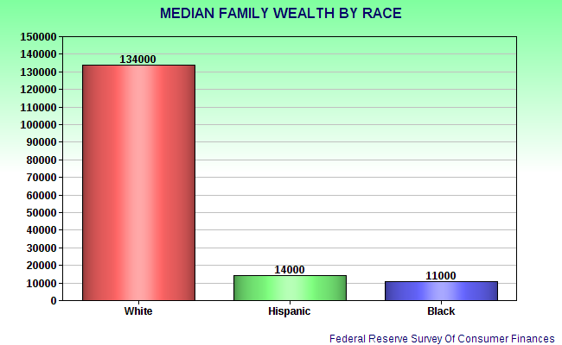
Prosperity and wealth creation is the American Dream

